Slide 1


Comet
Dash
A Web Dashboard for Classes at UTD
Prepared by Software Engineering Baddies

Slide 2


Meet the Team
Sophia Chau
Suchita Mamindla
Yara Abdelhadi
Kimberly Niemiec
Project Research
Project Management
Cost, Process Analysis
Testing, Architecture Design
Xander Corcoran
Hassan Hashemian
Bryan Macias
Ronan Rao
Cost, Design Analysis
Cost, Process Analysis
Testing, Architecture Design
Testing, Process Analysis

Slide 3
Table Of Contents
Overview
Implementation
Impact
What is Comet Dash?
How will we make Comet Dash?
Why do we want to make Comet Dash?

Slide 4
OVERVIEW

Slide 5

Objective
One stop shop for UTD students
Holistic view of classes, grades, assignments, and study habits
Dashboard elements to give information to students
Benefits: quick navigation, easy access, important information to grow

Slide 6
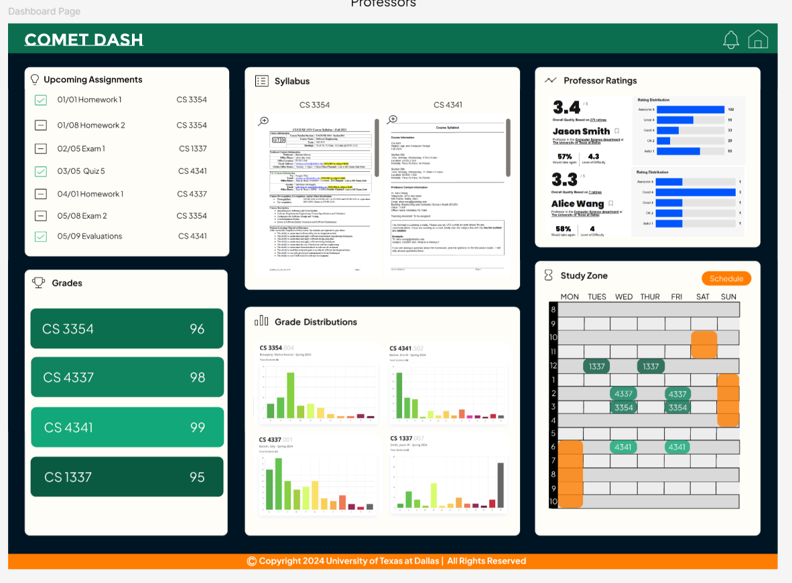
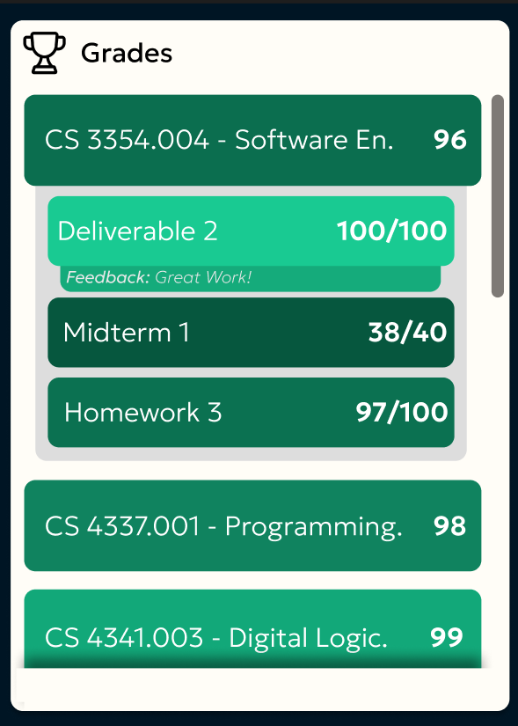
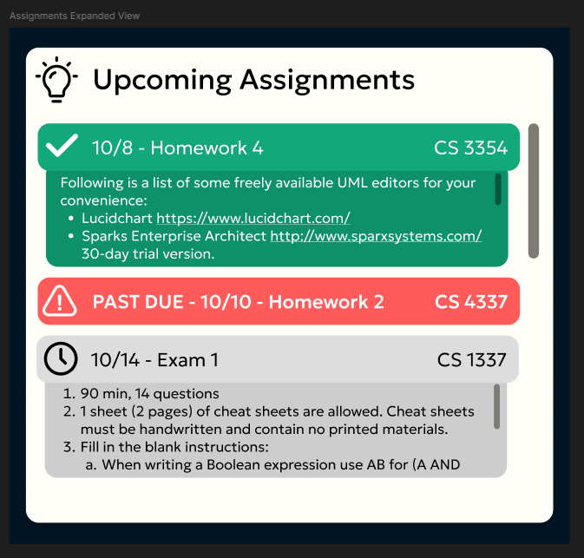
Comet Dash(board)

Slide 7

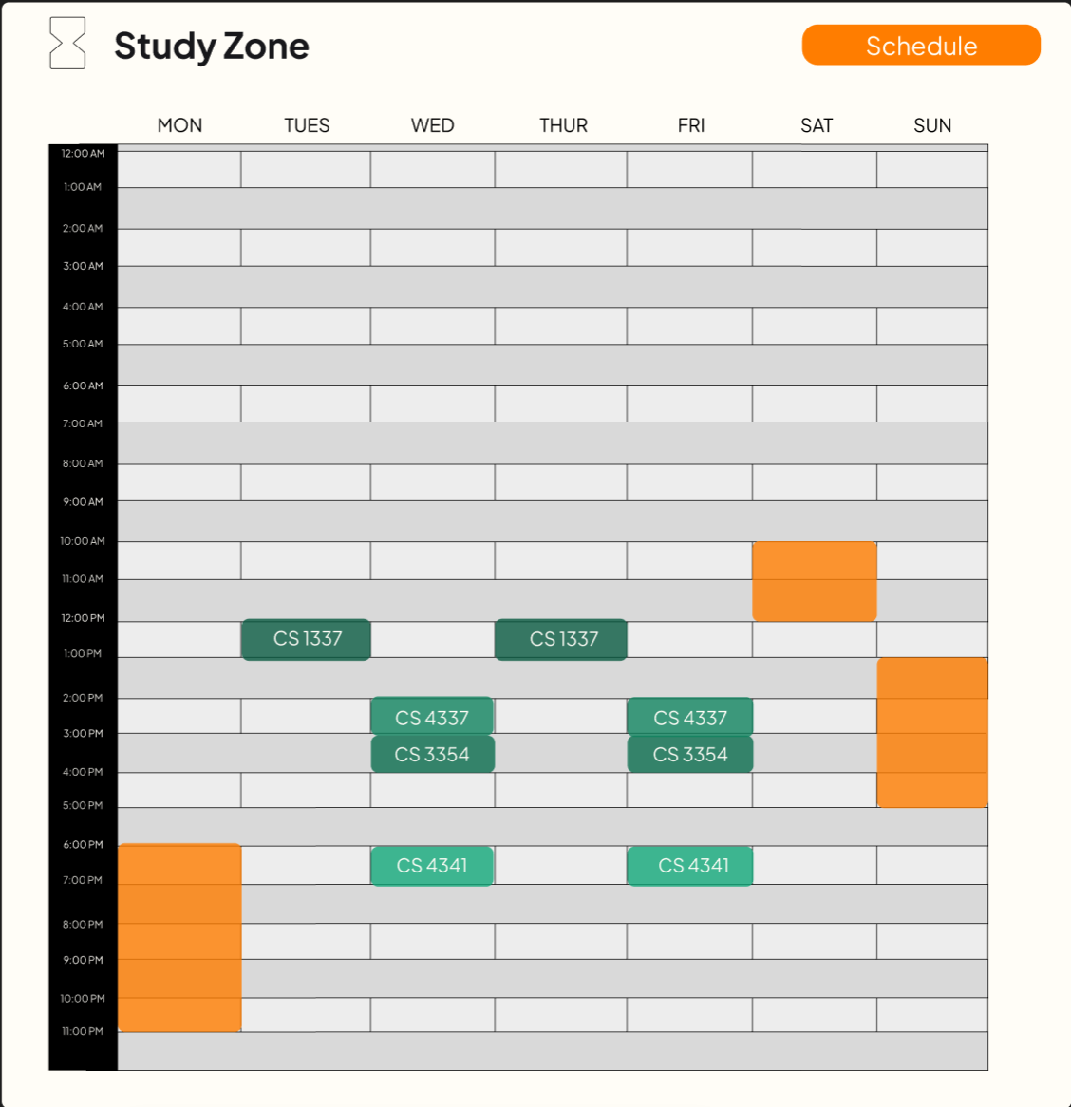
Study Zone

Slide 8

Functional Requirements
Student assignment reminders
Syllabus collection
Grade distribution statistics
Grades for each class
Rate my professor statistics
Study zone
Dashboard view

Slide 9
Non-Functional Requirements
Product requirement: Security
Data and PII must not be accessible by anyone but the user
Secure system that has protections against attacks
External requirement: Legal protection
Follows FERPA
If data is compromised, notify users as quickly as possible
Organizational requirement: Operational process
System is used by students only

Slide 10
Hardware, Software, and Production Costs
~$15K
~$1.5K
~$84K
Hardware
Software
Personnel
Workstations, testing devices, and servers
Frameworks, backend, databases, APIs, and libraries
Labor and training costs for interns over a semester.

Slide 11

DEMO

Slide 12
IMPLEMENTATION

Slide 13
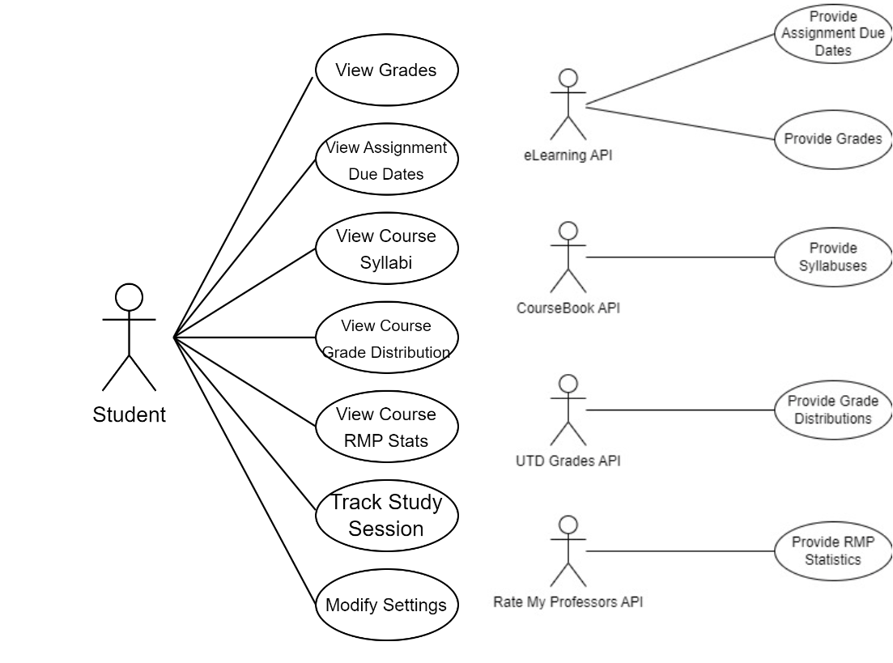
Use Case Diagram

Slide 14

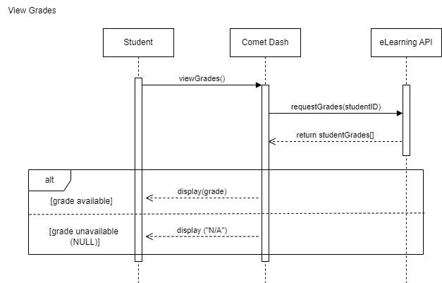
Sequence Diagram - View Grades

Slide 15
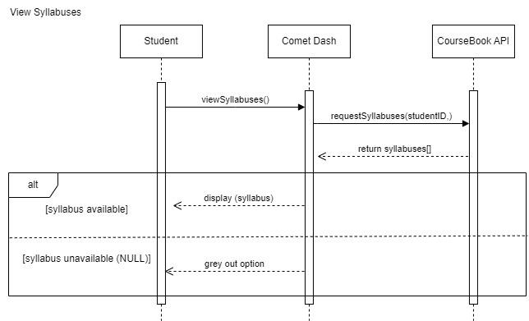
Sequence Diagram - View Syllabi

Slide 16
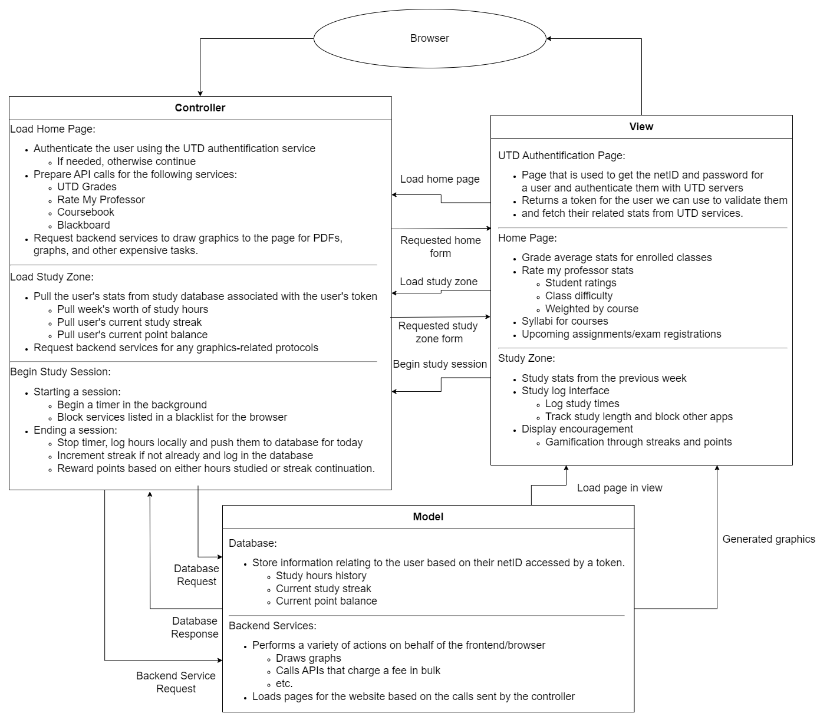
MVC Architecture
Comet Dash uses a Model-View-Controller architecture.
Model:
Stores database information for students
Provides backend services for drawing graphs and handling API calls.
View:
Renders the student dashboard.
Provides an interface for students to handle their study times and schedules
Allows for UI to be fed to the Controller.
Controller:
Handles rendering the dashboard using elements fetched from APIs.
Passess student statistics from the database to be used in the rendering of page elements.

Slide 17
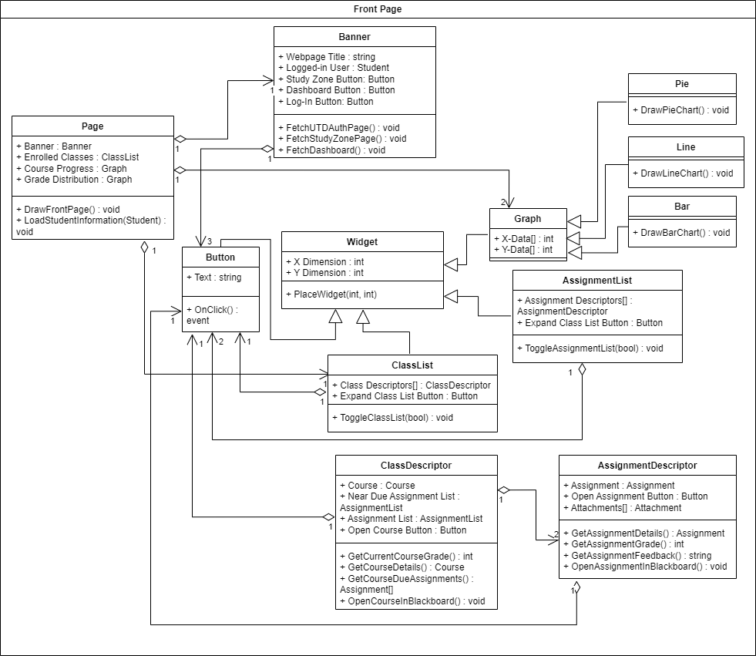
Classes - Front Page
Class Overview:
Page: Contains entire webpage
Widgets: Page tiles for displaying student statistics
Graph: Handles drawing graphs
ClassDescriptor: Specific widget for displaying classes
AssignmentDescriptor: Specific widget for displaying assignments.

Slide 18
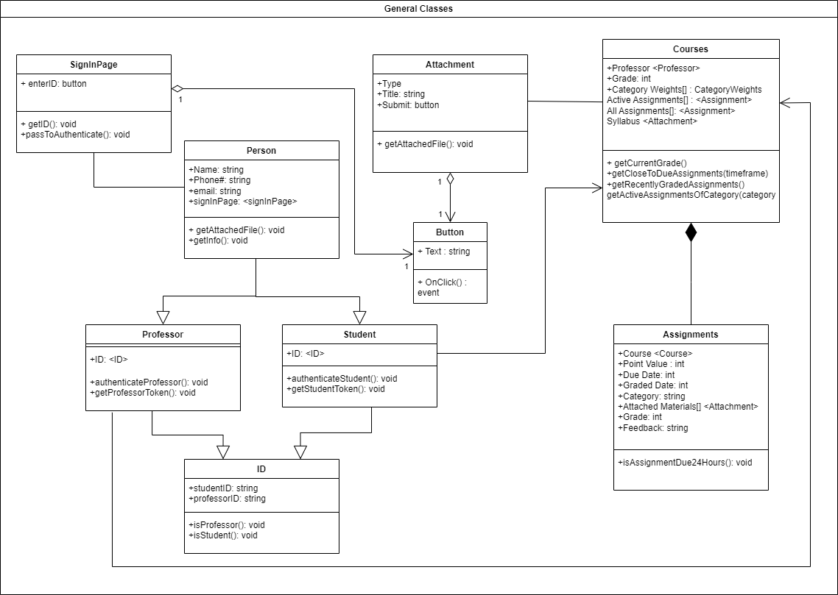
Classes - General Classes
Class Overview:
SignInPage: Contains sign in page
Person Class: Contains Identification for Professor or Student
Courses: Contains course information
Assignments: Assignment Information

Slide 19
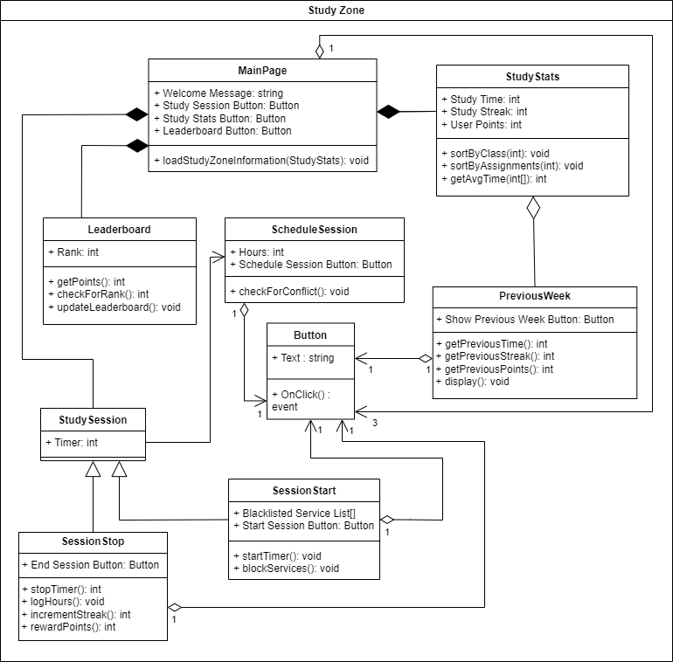
Classes - Study Zone
Class Overview:
Main Page: Contains the Main Page Widgets
Study Stats: Information for study stat block
Leaderboard,Schedule Session,Previous Week: Widget blocks for each
Session Start, Stop: Functions for Study Session

Slide 20
Test Plan
If a student starts a study session the applications listed on the ‘Blacklisted Service List’ will be blocked until the session is concluded.
Start a study session with no applications in the ‘Blacklisted Service List’. Check that the student is allowed to access any service during the session.
Start a study session with one application in the ‘Blacklisted Service List’. Check that the student is not allowed to access that service during the session.
Start a study session with two or more applications in the ‘Blacklisted Service List’. Check that the student is not allowed to access those services during the session.

Slide 21

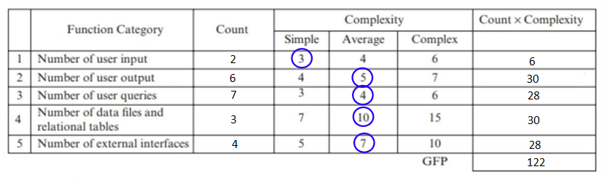
Function Point Estimation(FP)
Total PC: 17
PCA = 0.65 + 0.01(Total PC) = 0.65 + 0.01(17) = 0.82
FP = GFP x PCA = 122 x 0.82 = 100.04 FP

Slide 22
IMPACT

Slide 23
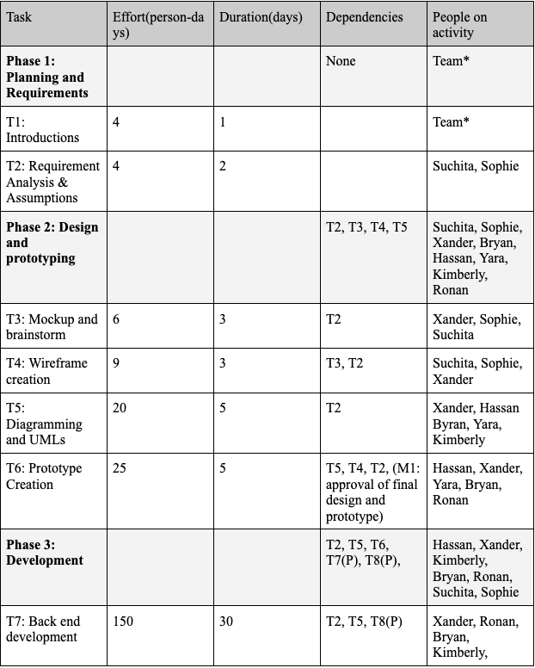
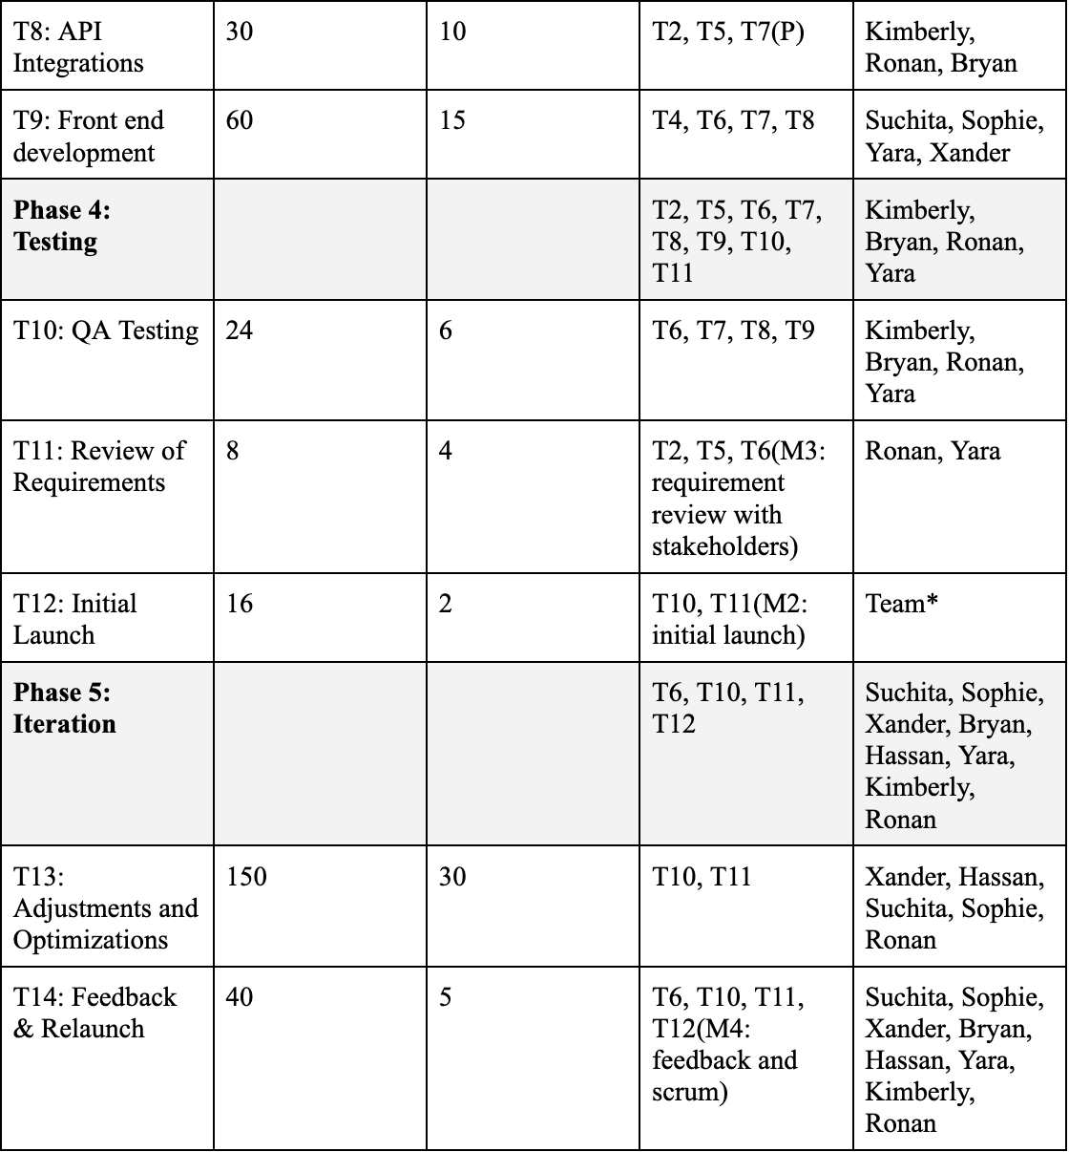
Project Scheduling
128 calendar days – 44 days skipped:[8]
Excluded 18 Saturdays, Excluded 18 Sundays, Excluded 8 holidays:
Thanksgiving Day, Day After Thanksgiving, Christmas Eve, Christmas Day, Day After Christmas Day, New Year's Day, Martin Luther King Jr. Day, Presidents' Day
Assumption: team members can work everyday 8-5
No restricted deadlines.
40% contingency plan for problems

Slide 24
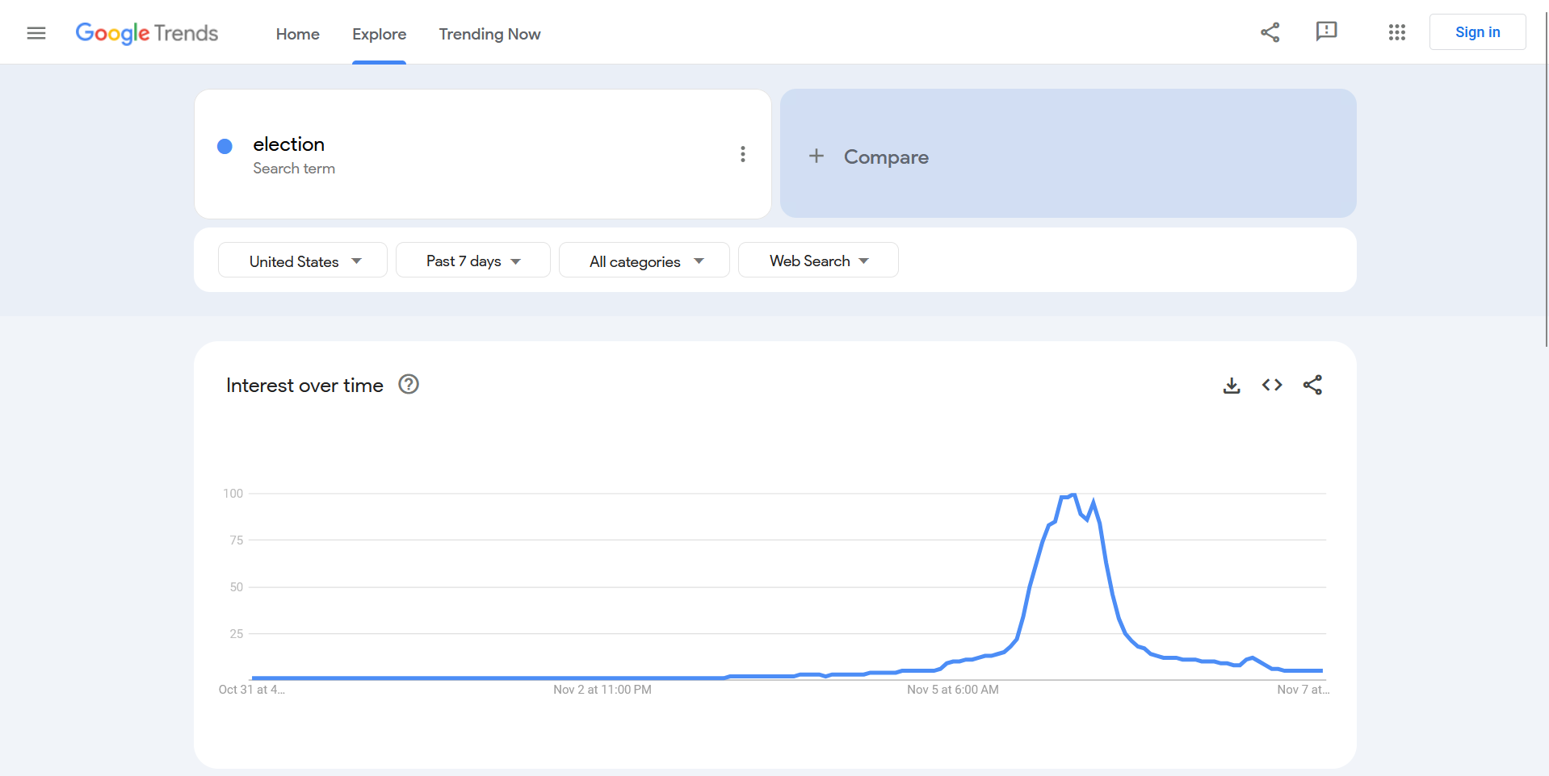
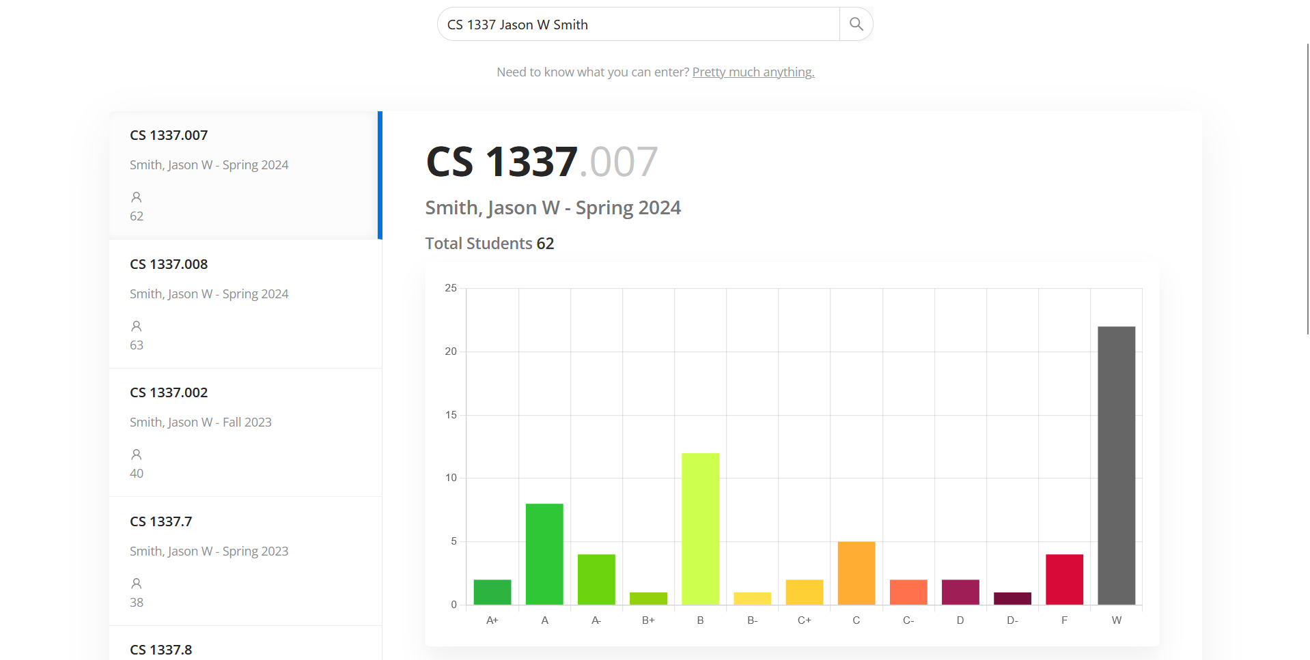
Comparisons
Dashboard focused product: Google trends
A focus on graphical elements to describe information in a quick but easy to understand manner
Education focused product: Blackboard
A focus on providing education-related information to users
Mix of the two: UTD grades
Has graphs about educational statistics

Slide 25
Conclusion
Development
Seamless API integrations and Agile methodology
Scalable software development accounting contingencies
Challenges
Various opinions on architecture styles from product versatility
Cost and contingency minor discrepancies accomodated
Accounted team experience levels
Outcome
Accurately estimated plan for user based software product
Realistic plan with UI/UX

